Slide 1
Take back control of your digital presence on the IndieWeb
Jan Tuomi
Notes:
Tell you… How I found out about IndieWeb,
my gripes with social media silos,
state of data ownership.
How to IndieWebify your digital presence

Slide 2

Image: indieweb.org
Notes:
Silo: (also walled garden)
Think of typical centralized sites like Facebook, X/Twitter, but also Netflix, Flickr…
Create a separate identity (account)
Allow posting content in specified form
Restricts or claims part of your content
Often algorithmically optimized

Slide 3
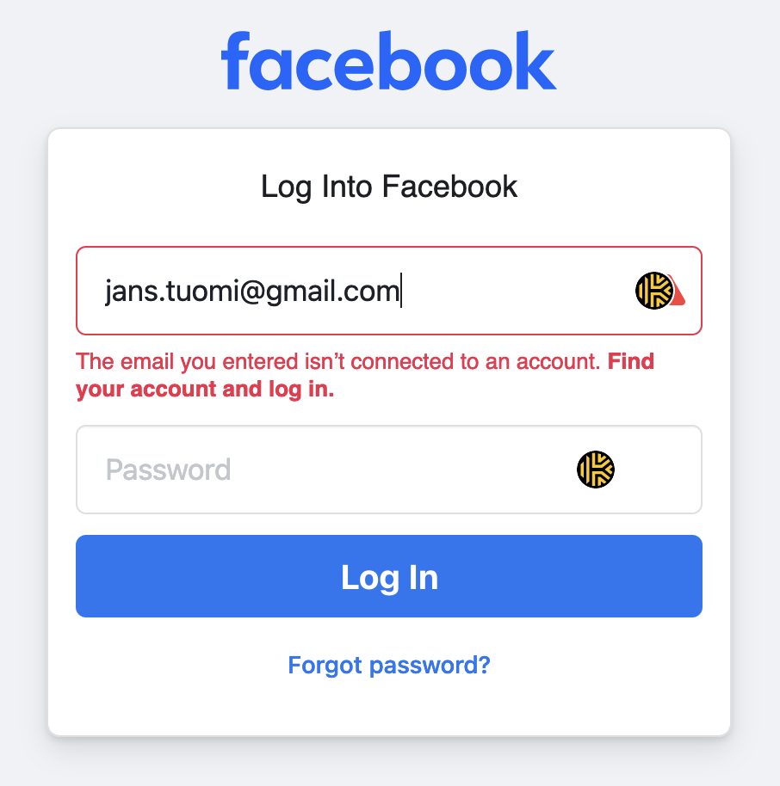
My view on social media silos
Notes:
I don’t use any social media (1), but I want to have a digital presence
Uncertainty about how data is used and managed
(1) …except for Mastodon, …using <1 year ago
Not very active, since I don’t like the twitter format

Slide 4
Alternative?
Connected, independent, personal websites
✨ IndieWeb ✨
(As opposed to the corporate web)

Slide 5
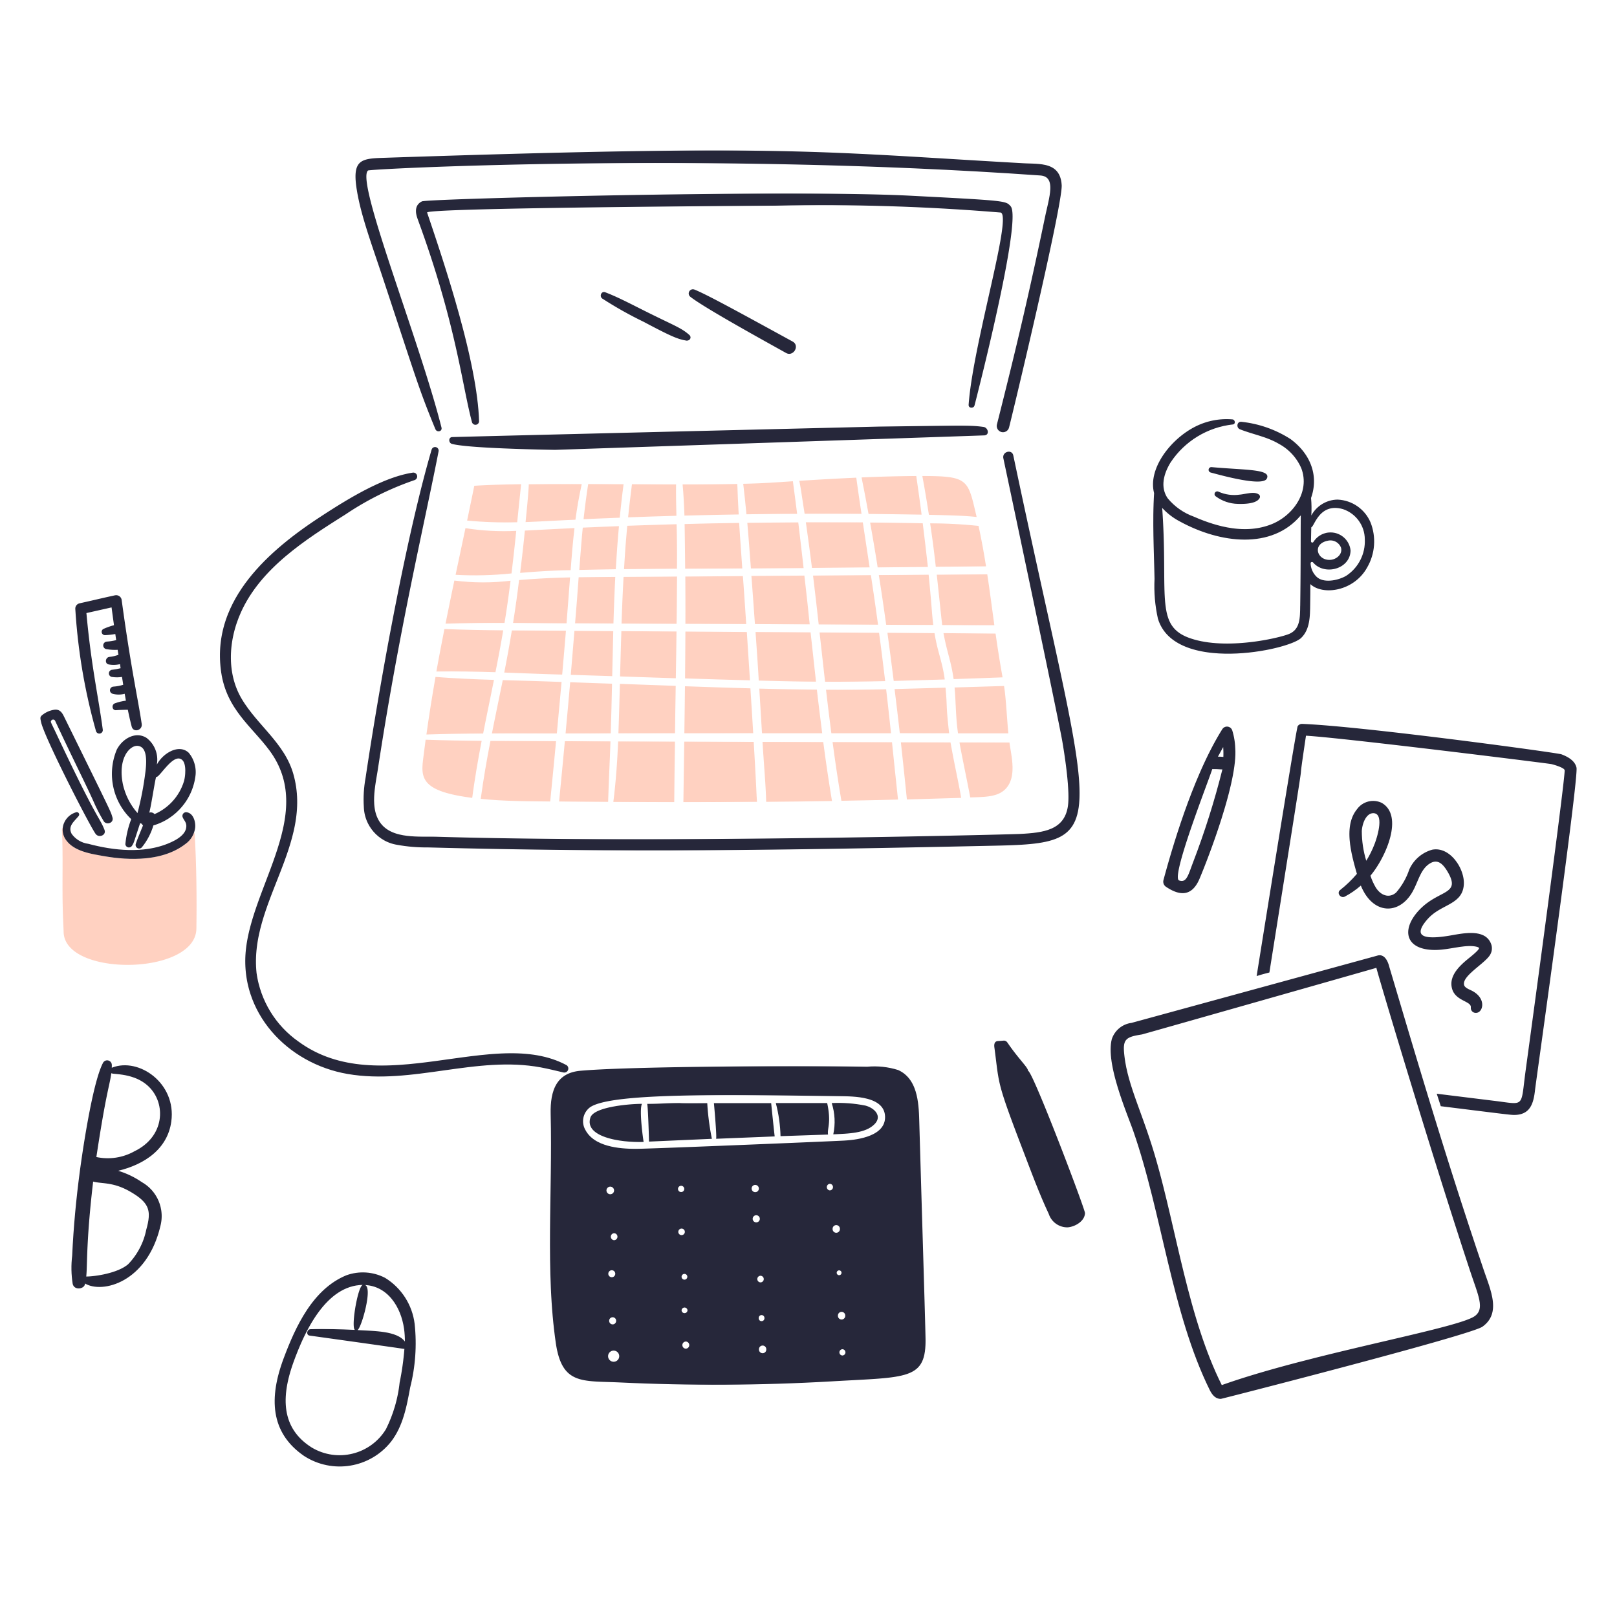
How?
Set of open standards
  Microformats, RSS/Atom
Principles
  Owning your domain and identity
  Syndication
Use any web hosting
  Wordpress, micro.pub, your own server, Github Pages…
Notes:
Just normal personal contentful websites, but with a certain mindset
your website is your identity
IndieAuth: https://indieauth.com/
Content over tools

Slide 6
indiewebify.me
Take IndieWeb building blocks gradually into use

Slide 7

Demo
Minimal example
  jan.systems
Maximal example
  bacardi55.io
With some Webmentions
  tantek.com

Slide 8
Wild stuff!
RSVP to events using Webmentions!
h-card for automatic profile retrieval!
Poetry markup!
Publish on Own Site, Syndicate Elsewhere (POSSE)

Slide 9



Your content is yours
You are better connected
You are in control

Slide 10
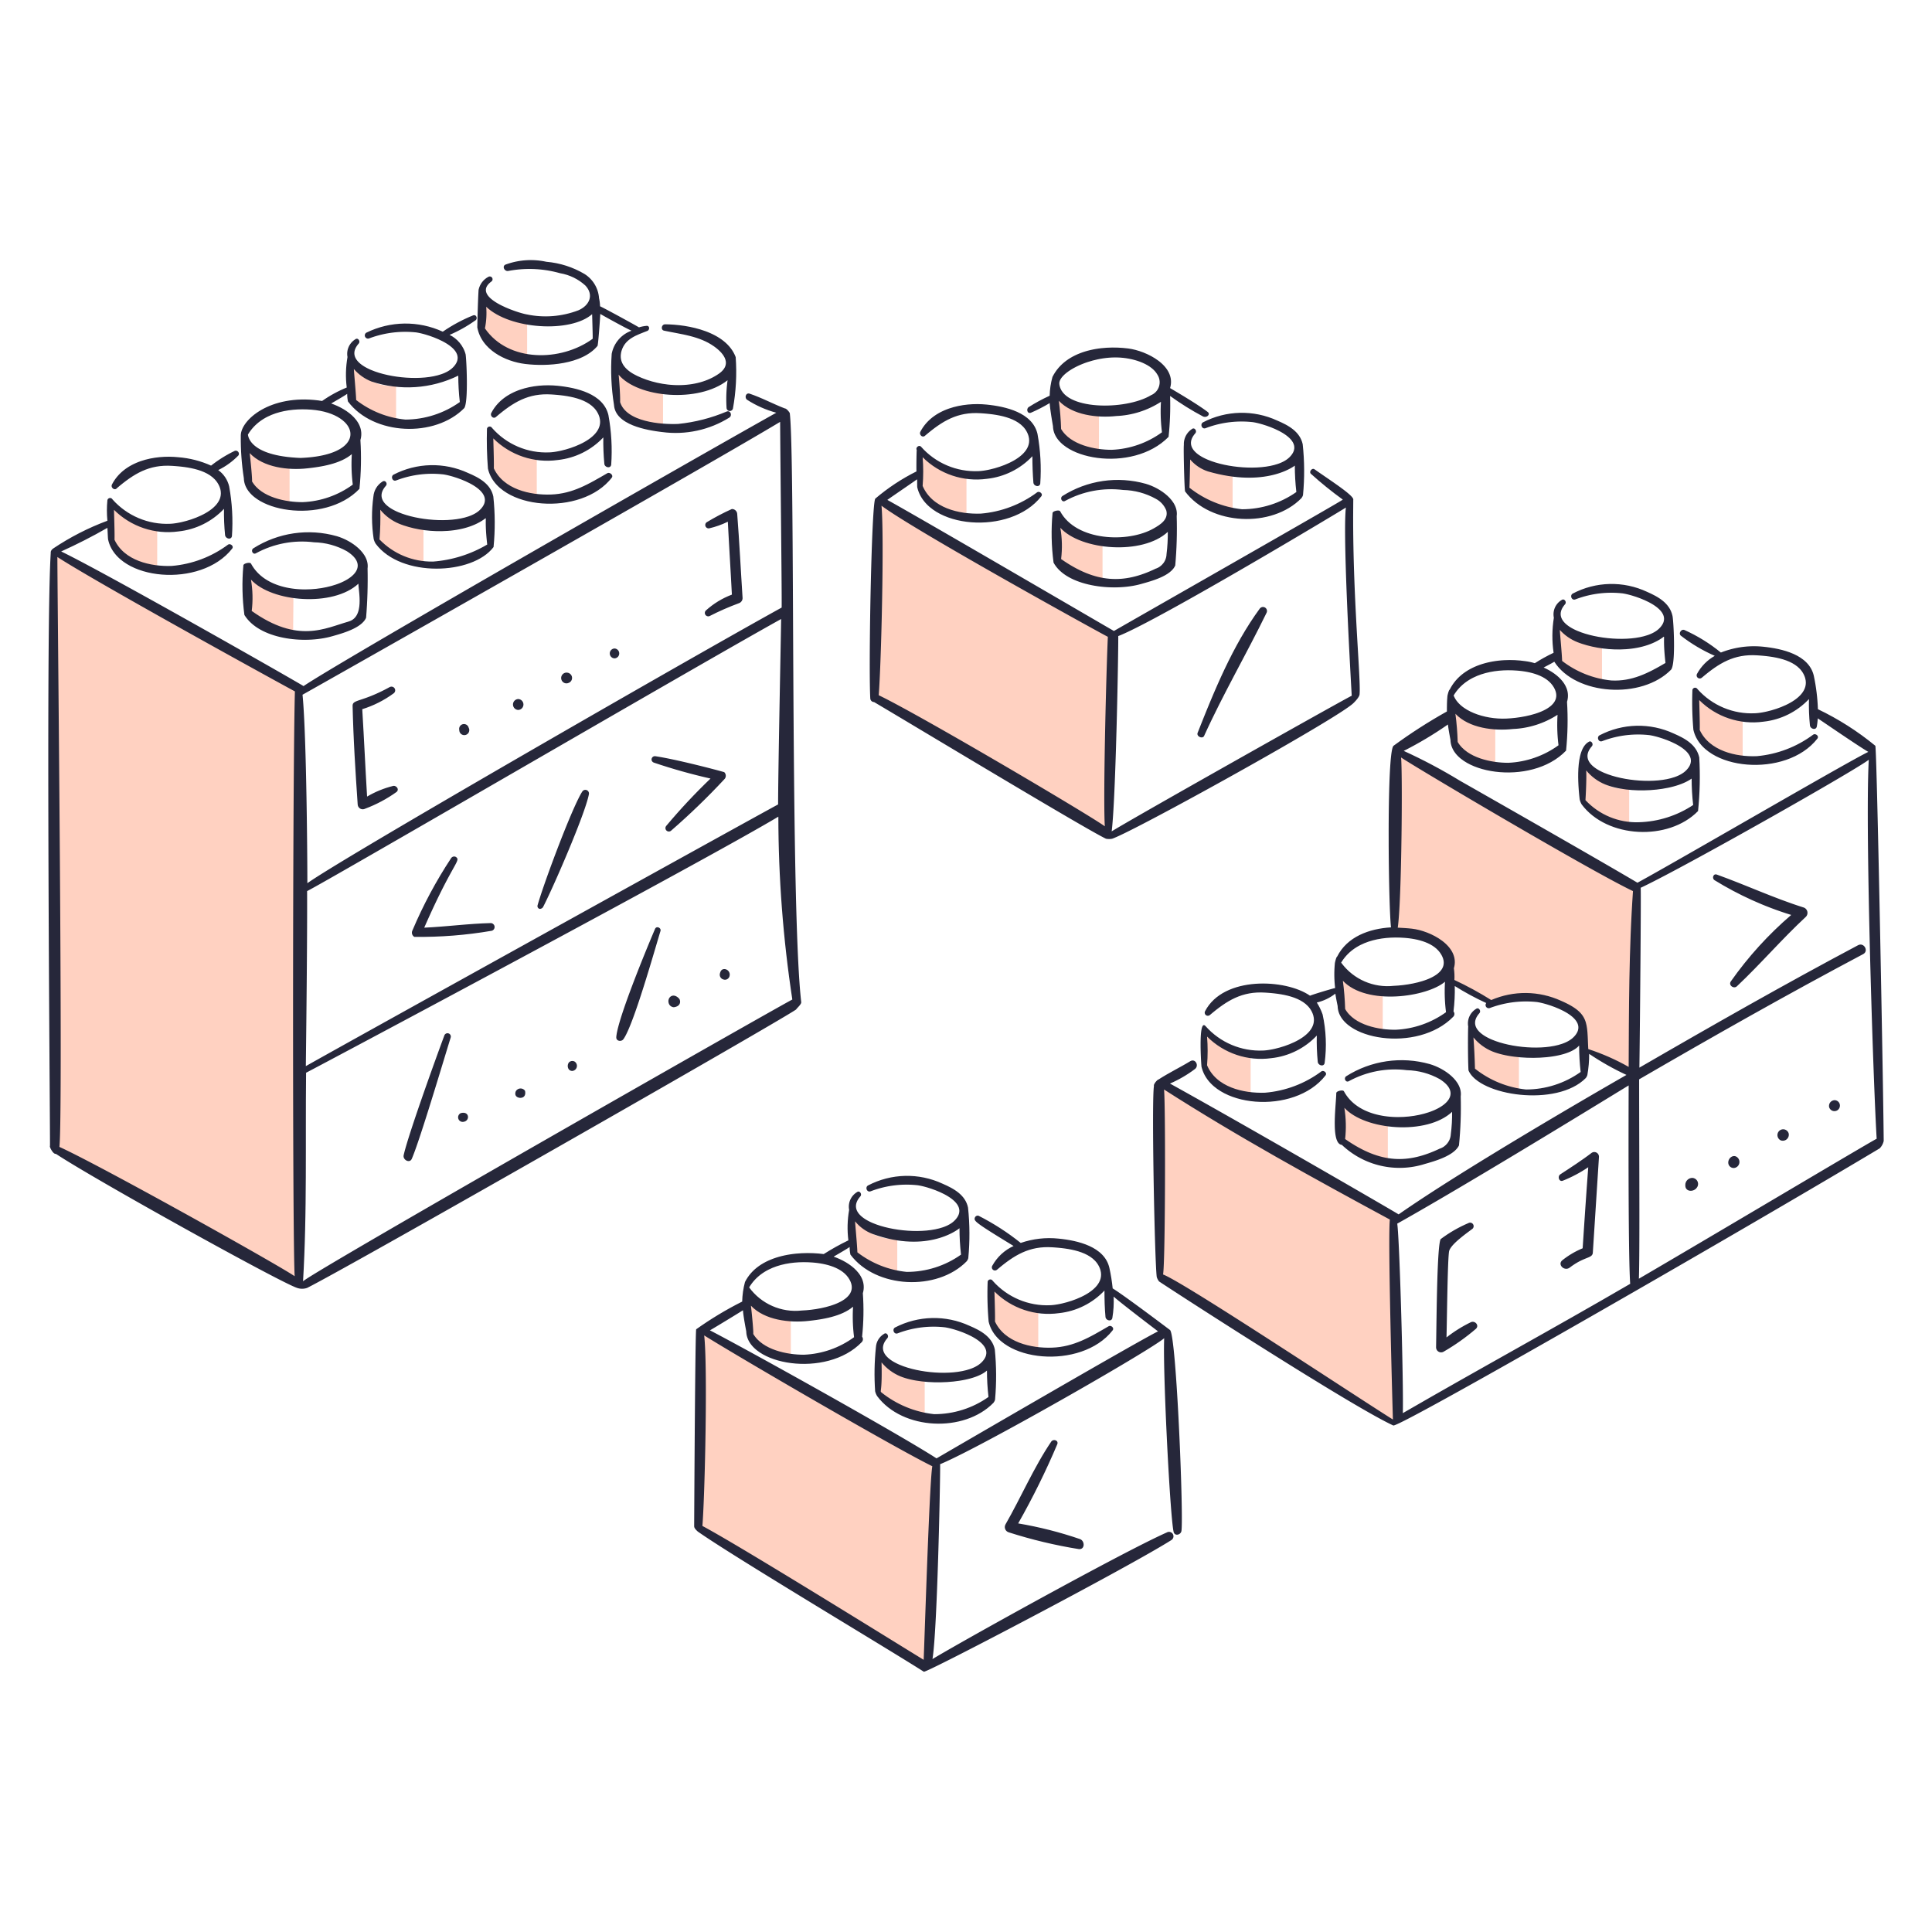
Learn more
indieweb.org – Getting Started
IndieWeb chat
Homebrew Website Club meetups
(in person and over Zoom)

